Slide 1
DATA MINING GROUP ASSIGNMENT

Slide 2
Table of Contents
Business Objective
Exploratory Data Analysis
Hypothesis Testing and Validation
Data Split – Development and Holdout samples
Data Visualization – Relationship between variables
Engineered Variables and creating Engineered Dataset
Model Development, Performance Measures and Validation
Original Dataset and Engineered Dataset
Model Implementation / Development Strategy
Assumptions

Slide 3
Business Objective
Objective
MyBank, is a bank and has come up with an intention to cross-sell Personal Loans.
What it did?
As part of their Pilot Campaign, 20000 customers were sent campaigns through email, sms, and direct mail.
Offer Detail
The offer on Personal Loan was an attractive interest rate of 12% , with waiving off processing fees if the customer responds within 1 Month.
Customer Response
2512 customer expressed their interest for the offer. Data was collected with these 2512 customers carrying a response flag of 1 by means of the variable Target. The data also included various demographics and behavioral variables with respect to individual customers.
Need from Analytics
MyBank wants to build a model using Supervised Learning Technique that will help in identifying profitable segments to target for cross-selling personal loans.

Slide 4
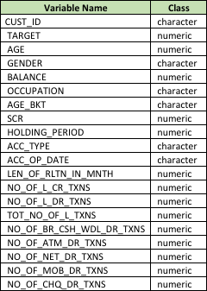
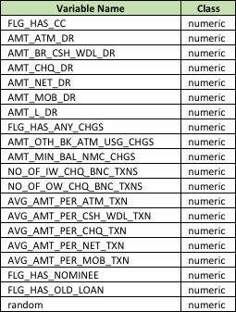
Dataset Overview – 1/3
DATASET
Team analyzed the data and identified that –
There are 20000 unique customer records spread across 40 attributes (variables) describing demographic, behavioral and banking transaction related information.
The 40 variables along with their classes are –

Slide 5
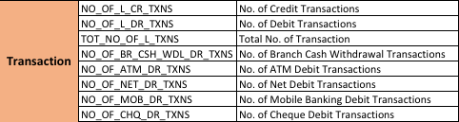


Dataset Overview – 2/3
Target variable is a categorical variable with values of 1 and 0, with 1 representing customers who showed interest for the Personal Loan offer.
The dataset has the following segments of variables –

Slide 6

Dataset Overview – 3/3
The dataset also has a variable named Random, which does not have any meta data information.
The data from the csv file looks as below –

Slide 7
EXPLORATORY DATA ANALYSIS

Slide 8
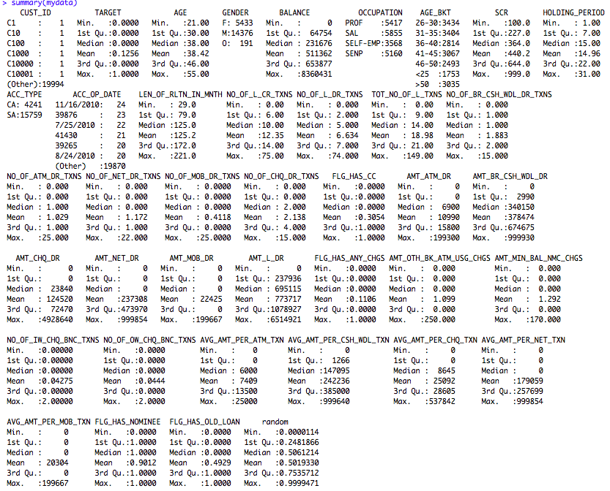
Exploratory Data Analysis – 1
DATA DIMENSION
There are 20000 observations across 40 features in the dataset
dim(mydata)
[1] 20000 40
SUMMARY OF VARIABLES
Customer ID is the unique identifier of each record
Target is the categorical variable which reflects the promotion loan preference of individual customers. The data suggests 12.56% of the 20000 customers has shown positive intent.
Age of customers ranges from 21 to 55 years with average age being ~38 years. With more than 3 times more Male customers than Female customers.
There are close to 4 times more savings accounts than current accounts.
The account balance seems to be skewed with maximum balance being ~836000 whereas average balance being ~ 511362.
A customer’s average relationship period with the bank is 125 months. The newest customer is 29 months old and the oldest customer has close to 19 years of relationship with the bank.
~11 % of the customers has incurred bank charges.
~90 % of the customers has a nominee registered.
~30 % of customers has credit card.
~50% of the customers have old loans.
More than 50% of the bank’s customers are either Professionals or Salaried.

Slide 9
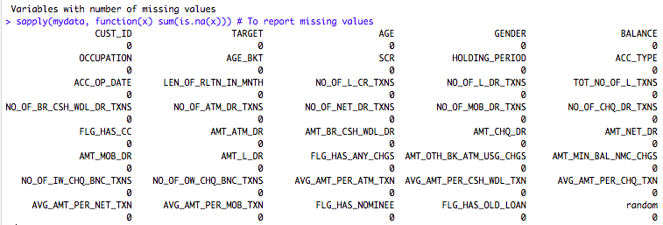
Exploratory Data Analysis – 2
SEARCHING FOR ANY MISSING VALUES
We checked the dataset for any missing values. The dataset is consistent in that terms and none of the features has any missing value.

Slide 10
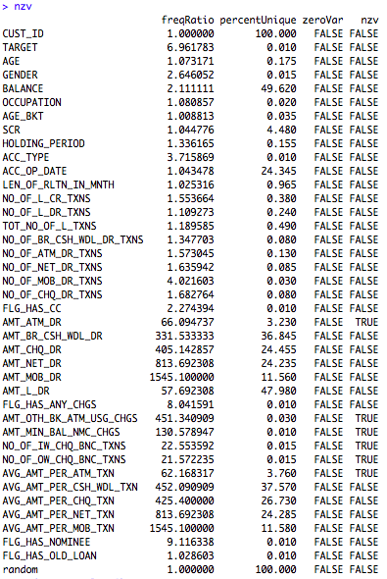
Exploratory Data Analysis – 3
ZERO AND NEAR ZERO VARIANCE
> #Finding for Zero Variance> nzv = nearZeroVar(mydata, saveMetrics = TRUE)
“Frequency Ratio” which is the ratio of most prevalent value to the second most prevalent value has clearly put Customer ID to 1 as all values in the variable are unique.
The same can be easily seen from the percent Unique field which talks about the value uniqueness in the data.
Zero Variance being false tells us that there are no variables having data with zero variance.
However, we do have few variables that have very low variance and the same has been marked as TRUE in the near zero variance field.

Slide 11
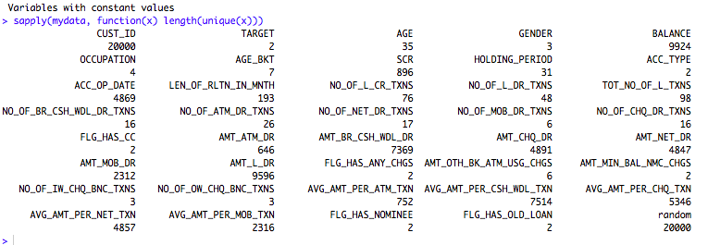
Exploratory Data Analysis – 4
SEARCHING FOR CONSTANT VALUES
We checked the dataset for constant values. The Customer ID and random variables are unique with 20000 different values.

Slide 12
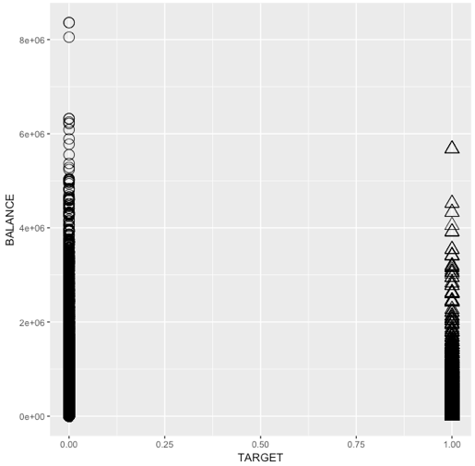
Exploratory Data Analysis – 5
DATA COMPARISON PLOTS
ggplot(data = mydata) + geom_point(mapping = aes(x = TARGET, y = BALANCE) , colour="blue", size=4.5,show.legend = T)
ggplot(data = mydata) ++ geom_count(mapping = aes(x =TARGET , y = ACC_TYPE), show.legend = TRUE)
TARGET vs BALANCE
TARGET vs ACCOUNT TYPE
There is no clear inference to suggest that people who have shown interest with the promotional Personal Loan (TARGET =1) has higher balance. The comparison below shows it otherwise.
Of the two account types Savings account holders seems to be more than Current account holders when deciding to show interest for the promotional Personal Loan (TARGET =1) has higher balance.

Slide 13
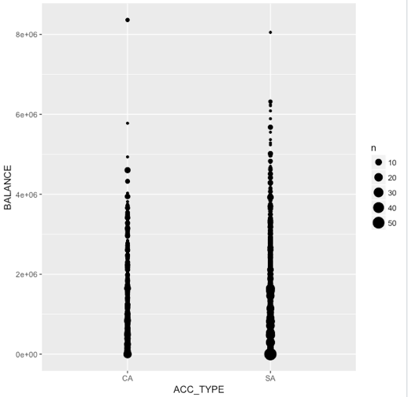
Exploratory Data Analysis – 6
DATA COMPARISON PLOTS
Given that the Savings account counts are more than the number of current accounts. The balance seems to be better concentrated in the savings account. However, current account holders holds the top most balance in terms of amount parked in the accounts.
ACCOUNT TYPE vs BALANCE
ggplot(data = mydata) + geom_count(mapping = aes(x =ACC_TYPE , y = BALANCE), show.legend = TRUE)

Slide 14
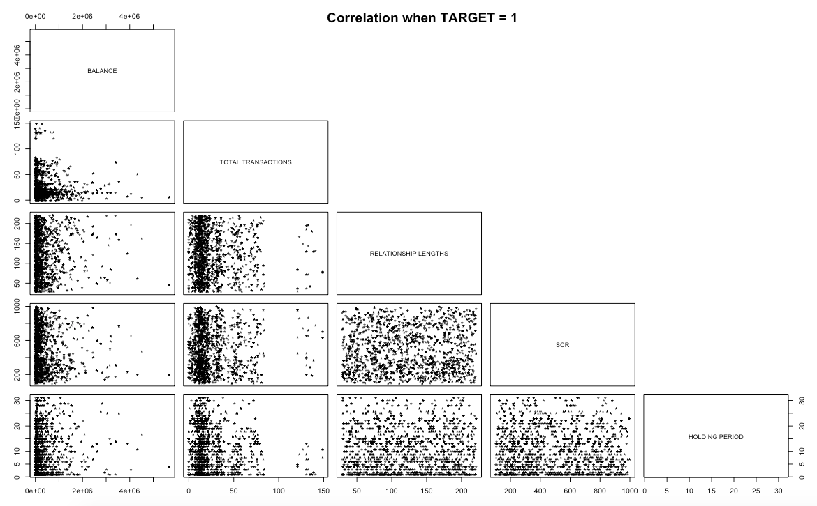
Relationship - Dependent and Independent Variables
pairs(cbind(BALANCE[TARGET==1],TOT_NO_OF_L_TXNS[TARGET==1],LEN_OF_RLTN_IN_MNTH[TARGET==1],SCR[TARGET==1],HOLDING_PERIOD[TARGET==1]),upper.panel=NULL,pch=42, labels =c("BALANCE","TOTAL TRANSACTIONS","RELATIONSHIP LENGTHS","SCR","HOLDING PERIOD"), main = "Correlation when TARGET = 1")
The adjacent plot is of the important variables when the dependent variable, TARGET is 1.
As we can see that there are some correlations between BALANCE and TOTAL TRANSACTIONS, RELATIONSHIP LENGTH, SCR and HOLDING PERIOD.
The density seems to be high at the base owing to the higher number of observations.
The presence of outliers can also be seen.

Slide 15
Hypothesis testing & Validation

Slide 16
Hypothesis Development & Validation
HYPOTHESIS
As TARGET is our given dependent variable, we need to ascertain if all/some of the other variables present in the data provides any relationship with the TARGET variable. For the same, we will be testing a hypothesis to check if all betas are zero or not. Formulating the Hypothesis,
Null Hypothesis : The statistical null hypothesis will be that the probability of a particular value of the TARGET variable is not associated with the value of any of other independent variables. In other words, the line describing the relationship between the measurement variables and the probability of the TARGET variable has a slope of zero as well as all other betas are zero.
Alternate Hypothesis : The alternate hypothesis will be that the TARGET variable is associated with other measurement variables. And at least one of betas is non-zero.
As TARGET is a categorical variable with probable values of 1 and 0; we will prepare a logistic regression model and predict the log likelihood ratio to verify the veracity of the Null Hypothesis.
We explored some relationship of variables as part of the exploratory data analysis and identified that some variables are seeming correlated. For the validation of this hypothesis, we are taking a subset of the data (6000 rows) and taking the variables
AGE
BALANCE
SCR
HOLDING_PERIOD
LEN_OF_RLTN_IN_MNTH
TOT_NO_OF_L_TXNS
VALIDATION

Slide 17
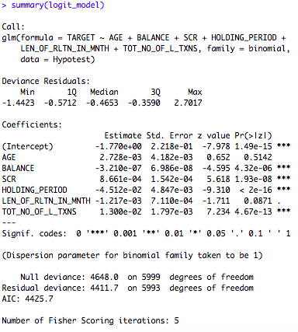
Hypothesis Development & Validation
LOG LIKELIHOOD RATIO & INTERPRETATION
logit_model=glm(TARGET~AGE+BALANCE+SCR+HOLDING_PERIOD+LEN_OF_RLTN_IN_MNTH+TOT_NO_OF_L_TXNS,data=Hypotest,family=binomial)
library(lmtest)
summary(logit_model)
like_prob=lrtest(logit_model)
like_prob
The overall test of significance based on Chisq test seems to be significant indicating the likelihood of TARGET depending upon the AGE, BALANCE, SCR, HOLDING PERIOD, LENGTH OF RELATIONSHIP AND TOTAL NUMBER OF TRANSACTIONS. Also, the p-value is significantly lower.
The above implies that the Null Hypothesis which refers to all betas to be 0 (zero) should be rejected and it is safe to conclude that atleast one Beta is non-zero.
This assessment helps us in proceeding with our effort towards segmenting the data. The following sections will explore the same along with the best approach, interpretation and implementation.

Slide 18
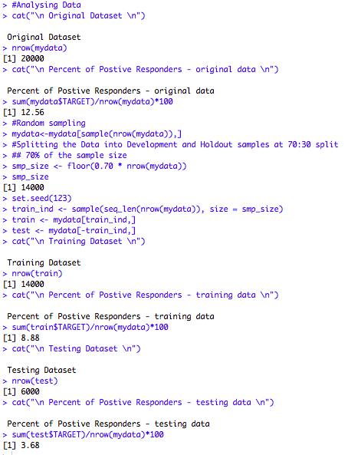
Data Split
The dataset with 20000 observations across 40 features has been split into 2 datasets with 70:30 proportion.
Dataset with 70% observations (14000 rows) is considered as the training/development dataset
Dataset with the remaining 30% (6000 rows) is considered as the testing/holdout dataset.
The original dataset with 12.56 % of positive responders was broken into 2 samples – development and holdout in the proportion of 70:30.
The development dataset has 8.88 % of positive responders
The testing dataset has 3.68 % of the positive responders.
#Randomly shuffle the data
mydata<-mydata[sample(nrow(mydata)),]
#Splitting the Data into Development and Holdout samples at 70:30 split
## 70% of the sample
sizesmp_size <- floor(0.70 * nrow(mydata))
smp_size
set.seed(123)
train_ind <- sample(seq_len(nrow(mydata)), size = smp_size)
train <- mydata[train_ind,]
test <- mydata[train_ind,]
write.csv(train,file="dev_sample.csv")
write.csv(test,file="holdout_sample.csv")

Slide 19
Feature Engineering / Derived Variables
The dataset with 20000 observations has enough details about customers both personal as well as operational. However, while looking deeper we found that there are no variables that tells about the average monthly counts. So, we are planning to use the below additional transactions variables along with the available data.
Average # of transactions per month = Total Number of Transactions / Length of relationship in months
NEW_TOT_TRAN_PER_MTH = TOT_NO_OF_L_TXNS/LEN_OF_RLTN_IN_MNTH
Average # of debit transactions per month = Total Number of Debit Transactions / Length of relationship in months
NEW_TOT_DB_PER_MTH = NO_OF_L_DR_TXNS/LEN_OF_RLTN_IN_MNTH
Average # of credit transactions per month = Total Number of Credit Transactions / Length of relationship in months
NEW_TOT_CR_PER_MTH = NO_OF_L_CR_TXNS/LEN_OF_RLTN_IN_MNTH
Average debited amount per month = Total amount in Debits / Length of relationship in months
NEW_AVG_DB_AMT_PER_MTH = AMT_L_DR/ LEN_OF_RLTN_IN_MNTH
Total Bank Charges paid = Sum of all charges paid by the customer
NEW_TOT_BNK_CHRGS=AMT_OTH_BK_ATM_USG_CHGS+AMT_MIN_BAL_NMC_CHGS+ NO_OF_IW_CHQ_BNC_TXNS + NO_OF_OW_CHQ_BNC_TXNS
Average # of bank visits per month = # of cash withdrawals at branch / Length of relationship in months
NEW_AVG_BNK_VST_PER_MTH = NO_OF_BR_CSH_WDL_DR_TXNS/LEN_OF_RLTN_IN_MNTH

Slide 20
MODEL DEVELOPMENT
APPROACH
We are going to use Random Forest to do the segmentation. Reasons being –
Its efficiency on large databases and ability to handle large number of input variables
Its performance stability with categorical variables. Our dataset has several categorical variables.
It gives estimates of what variables are important in the classification.
It generates an internal unbiased estimate of the generalization error as the forest building progresses.
METHOD
Step 1 – Model Development using the Original Dataset
Use Random Forest on the development dataset from the original data to create a model
Identify input variable’s importance based on Mean Decrease in Gini and Accuracy
Tune the Random Forest using tuneRF to identify the best number of variables to use in each iteration
Prediction scores for individual observation
Deciling the data
Ranking the data and viewing the overall ranking
Analyzing the model performance measures

Slide 21
MODEL DEVELOPMENT
Step 2 – Model Development using the Engineered Dataset
Incorporate the engineered variables in the development dataset and running Random Forest on the same
Identify input variable’s importance based on Mean Decrease in Gini and Accuracy
Tune the Random Forest using tuneRF to identify the best number of variables to use in each iteration
Prediction scores for individual observation
Deciling the data
Ranking the data and viewing the overall ranking
Analyzing the model performance measures
Step 3 – Comparing both the models (Original Development data model Vs Engineered Variable’s Development Model
Interpret both the models by comparing the KS statistic, AUC, Gini and the response rate
Interpret the engineered model by drawing business significance of the engineered variables

Slide 22
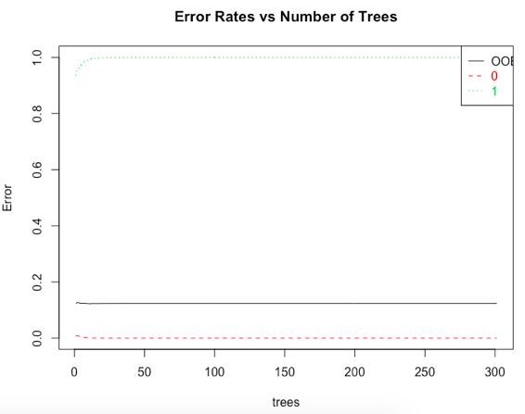
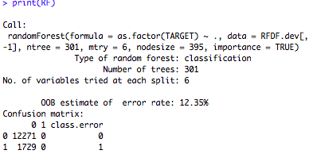
MODEL DEVELOPMENT – Step 1 (1/8)
Use Random Forest on the development dataset from the original data
RF <- randomForest(as.factor(TARGET) ~ ., data = RFDF.dev[,-1], ntree=301, mtry = 6, nodesize = 395, importance=TRUE)print(RF)
Random Forest ran with
nTree =301
mTry = 6 #Approximate Sqrt of # of variables
nodesize=395
OOB error is reported as 12.35 %

Slide 23
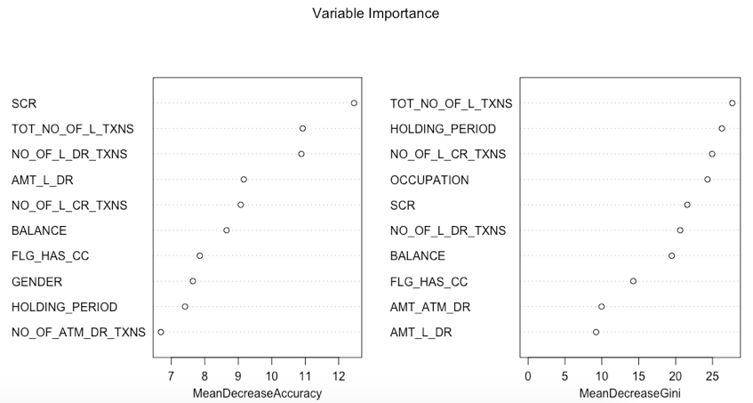
MODEL DEVELOPMENT – Step 1 (2/8)
Top variables identified as per Mean decrease in Accuracy and Mean decrease in Gini is as per the chart.
Gini treats Total number of transactions to be important whereas Accuracy measure is treating SCR to be the most important variable.

Slide 24
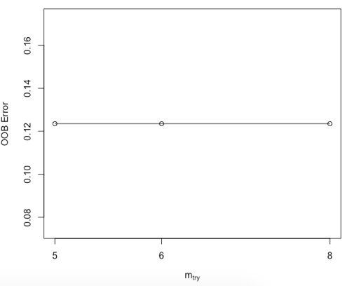
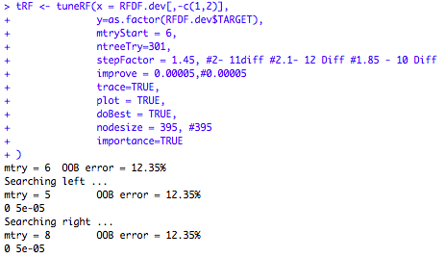
MODEL DEVELOPMENT – Step 1 (3/8)
Tuning the Random Forest
With the parameters of –
mtry=6
ntreeTry=301
stepFactor = 1.45
improve = 0.00005
nodesize = 395
The Tune RF method helped identify the optimum number of variables as 8 with improvement steps of 1.45.

Slide 25
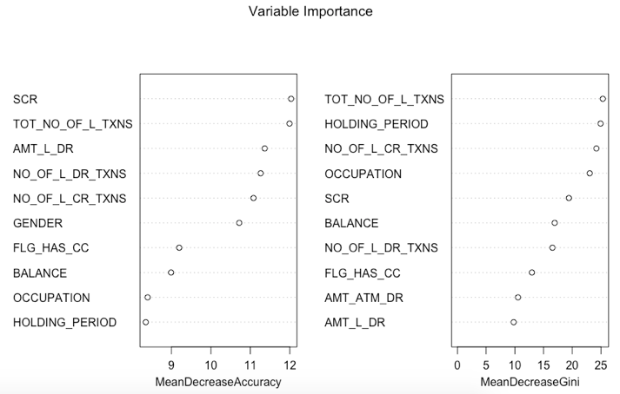
MODEL DEVELOPMENT – Step 1 (4/8)
Variable importance as obtained from tuned Random Forest
Tuned Random Forest has not changed the top important variables in terms of GINI and Accuracy as observed in the initial model.

Slide 26
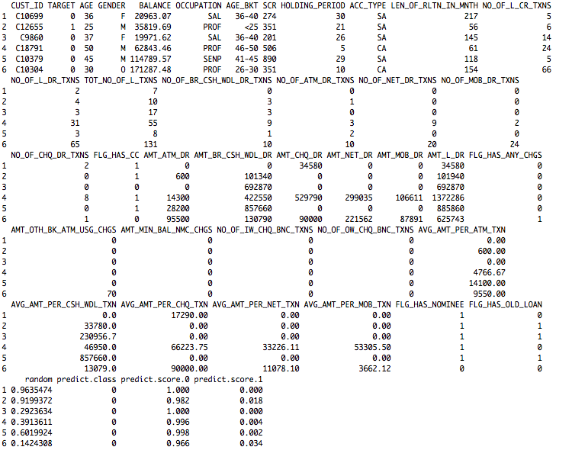
MODEL DEVELOPMENT – Step 1 (5/8)
Identifying Predict Class and Score
Once the tuned Random Forest is generated,
Obtain the prediction score and class.
Append the 2 new variables predict.class, predict.score.0 and predict.score.1 to the development data.

Slide 27
MODEL DEVELOPMENT – Step 1 (6/8)
Create Deciles and Ranking
The next step is to group the development set based on predict.score into 10 groups.
Ranking the deciles based on the average response rates.
Response Rate and KS
Response rate of the top decile interprets the highest predicted response rate for the plan
From the above table, 55% of the customers in the top decile having 1447 customers will respond favorably to the cross-selling of promotional Personal Loan.

Slide 28
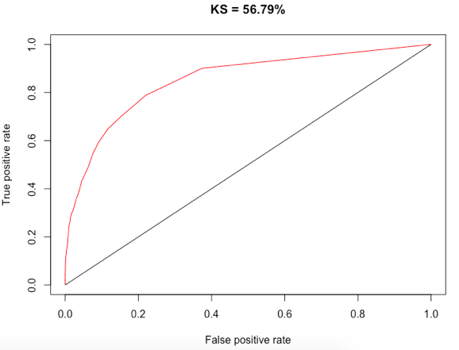
MODEL DEVELOPMENT – Step 1 (7/8)
Performance Measures
Kolmogorov-Smirnov (KS) statistics measures the predictive power of the model.
From our tuned model, the KS score is 0.5679
Area Under Curve (AUC), of our tuned model is 0.8523
GINI value is 0.8453

Slide 29
MODEL DEVELOPMENT – Step 1 (8/8)
Performance Measures
Lift Chart helps us compare the lift in response rates across the individual deciles. This will help the marketing team of MyBank to decide which deciles to target for the cross-selling.
The lift in the table below has shown to improve the top decile of customer’s response rate more than 4 times from the initial response rate of 12.56.

Slide 30
original Data MODEL Performance on HOLDOUT

Slide 31
MODEL PERFORMANCE ON HOLDOUT – 1/3
We ran the tuned Random Forest Model based on the Holdout dataset. The holdout sample had 6000 observations across the 40 variables
> RFDF.holdout <- read.table("holdout_sample.csv", sep = ",", header = T)
> RFDF.holdout = RFDF.holdout[,-1]> c(nrow(RFDF.dev), nrow(RFDF.holdout))
[1] 14000 6000
The steps being –
Implementing the tuned random forest model on the holdout sample and adding the predict.score and predict.class
Deciling the holdout sample based on predict.score
Ranking as per deciles with respect to the response rate.
Comparison of Development and Holdout results.

Slide 32
MODEL PERFORMANCE ON HOLDOUT – 2/3
Holdout Ranking
Development Ranking
KS statistic has reduced from 0.55 in Development to 0.45 in Holdout
Response rate has reduced from 55% in Development to 47% in Holdout

Slide 33
MODEL PERFORMANCE ON HOLDOUT – 3/3
Holdout Lift Chart
Development Lift Chart
The lift in Holdout sample close to 4 times in the top decile which is similar to the lift in the Development sample
Overall lift in the Holdout sample is consistent and is at least 1.8 times on little less than 50 % of the sample size

Slide 34
Engineered Data Model Creation and Performance Analysis

Slide 35
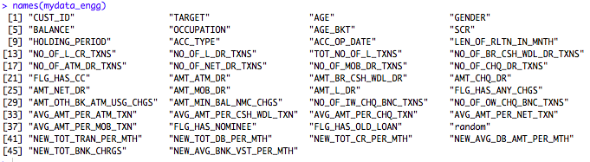
MODEL DEVELOPMENT – Step 2 (1/9)
Model Development using the Engineered Dataset
This section will explain our effort on preparing the random forest model based on the engineered dataset. As mentioned in Slide 17. The following new variables have been added to the original dataset.
NEW_TOT_TRAN_PER_MTH = TOT_NO_OF_L_TXNS/LEN_OF_RLTN_IN_MNTH
NEW_TOT_DB_PER_MTH = NO_OF_L_DR_TXNS/LEN_OF_RLTN_IN_MNTH
NEW_TOT_CR_PER_MTH = NO_OF_L_CR_TXNS/LEN_OF_RLTN_IN_MNTH
NEW_AVG_DB_AMT_PER_MTH = AMT_L_DR/ LEN_OF_RLTN_IN_MNTH
NEW_TOT_BNK_CHRGS = AMT_OTH_BK_ATM_USG_CHGS + AMT_MIN_BAL_NMC_CHGS + NO_OF_IW_CHQ_BNC_TXNS + NO_OF_OW_CHQ_BNC_TXNS
NEW_AVG_BNK_VST_PER_MTH = NO_OF_BR_CSH_WDL_DR_TXNS/LEN_OF_RLTN_IN_MNTH
The column names of the new dataset (engineered) is as below. Also, total number of variables is 46 including Customer ID.

Slide 36
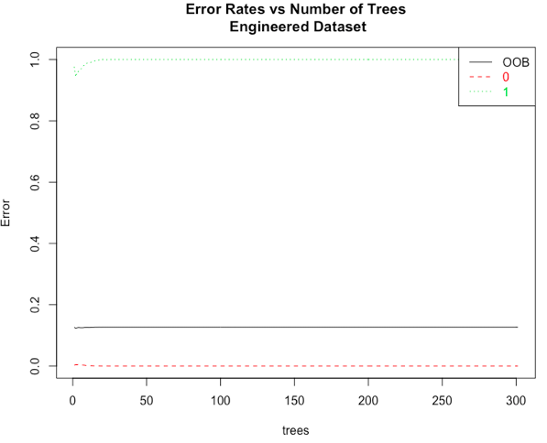
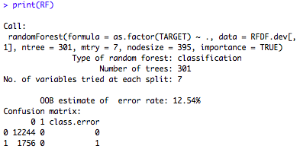
MODEL DEVELOPMENT – Step 2 (2/9)
Use Random Forest on the engineered development dataset from the original data
> RF <- randomForest(as.factor(TARGET) ~ ., data = RFDF.dev[,-1], + ntree=301, mtry = 6, nodesize = 395,+ importance=TRUE)
Random Forest ran with
nTree =301
mTry = 6 #Approximate Sqrt of # of variables
nodesize=395
OOB error is reported as 12.54 %

Slide 37
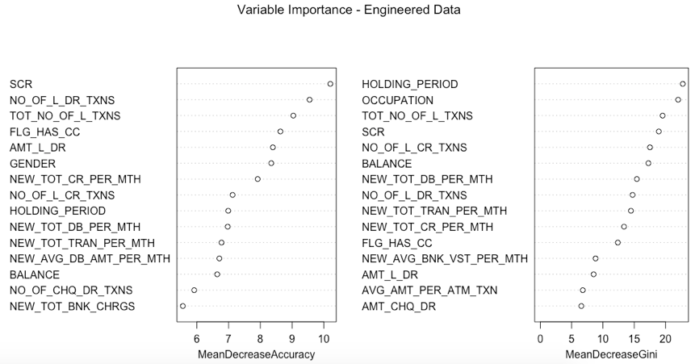
MODEL DEVELOPMENT – Step 2 (3/9)
Top variables identified as per Mean decrease in Accuracy and Mean decrease in Gini is as per the chart. As we can notice the engineered variables of Total Transactions per month and Total Debit per month has been appreciated to be important as per decrease in GINI. Also, Accuracy wise as well the both in addition to Total Credits per month has come up to be important.

Slide 38
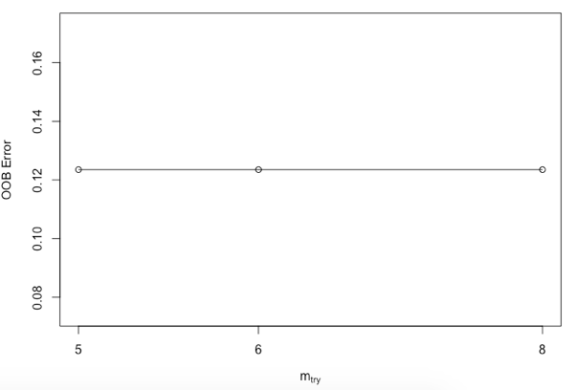
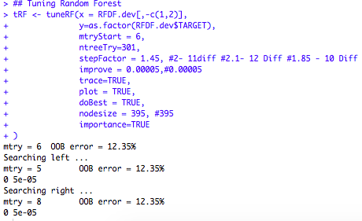
MODEL DEVELOPMENT – Step 2 (4/9)
Tuning the Random Forest
## Tuning Random ForesttRF <- tuneRF(x = RFDF.dev[,-c(1,2)], y=as.factor(RFDF.dev$TARGET), mtryStart = 6, ntreeTry=301, stepFactor = 1.45, improve = 0.00005,trace=TRUE, plot = TRUE, doBest = TRUE, nodesize = 395, importance=TRUE)
With the parameters of –
mtry=6
ntreeTry=301
stepFactor = 1.45
The Tune RF method helped identify the optimum number of variables as 8.
improve = 0.00005
nodesize = 395

Slide 39
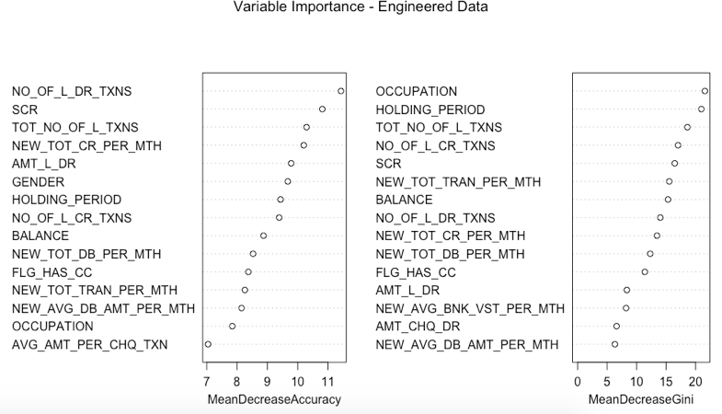
MODEL DEVELOPMENT – Step 2 (5/9)
Variable importance as obtained from tuned Random Forest. Highlighting the engineered variables.
Tuned Random Forest has changed the importance order of the variables. SCR is the most important in terms of GINI and Accuracy. Also, significance of engineered variables is clearly visible.

Slide 40
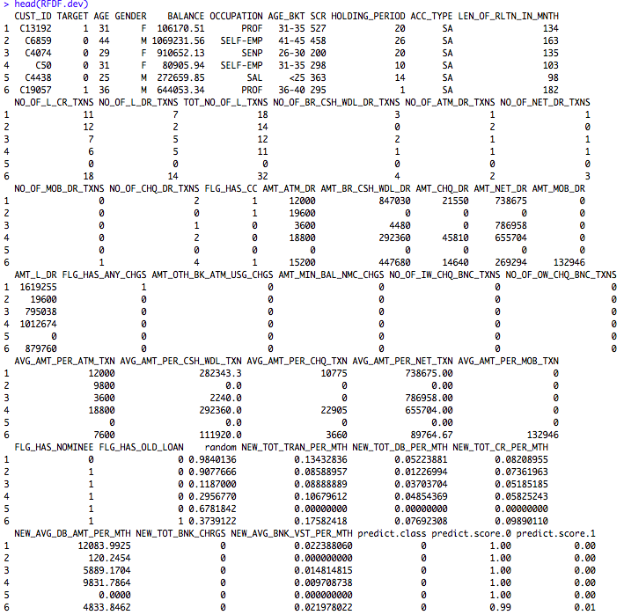
MODEL DEVELOPMENT – Step 2 (6/9)
Identifying Predict Class and Score
Once the tuned Random Forest is generated,
Obtain the prediction score and class.
Append the 2 new variables predict.class, predict.score.0 and predict.score.1 to the development data.

Slide 41

MODEL DEVELOPMENT – Step 2 (7/9)
Create Deciles and Ranking
The next step is to group the development set based on predict.score into 10 groups.
Ranking the deciles based on the average response rates.
Response Rate
Response rate of the top decile interprets the highest predicted response rate for the plan
From the above table, 57% of the customers in the top decile having 1496 customers will respond favorably to the cross-selling of promotional Personal Loan.

Slide 42
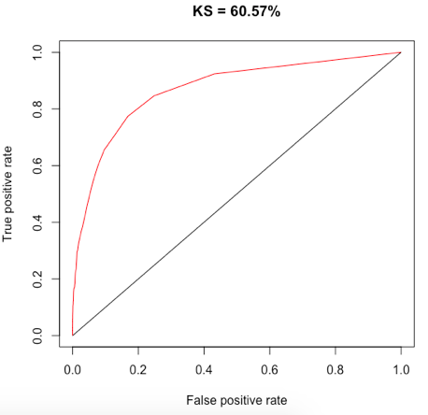
MODEL DEVELOPMENT – Step 2 (8/9)
Performance Measures
Kolmogorov-Smirnov (KS) statistics is measures the predictive power of the model.
From our tuned model, the KS score is 0.6057
Area Under Curve (AUC), of our tuned model is 0.8690
GINI value is 0.8244
Prediction Accuracy is ~87 %

Slide 43
MODEL DEVELOPMENT – Step 2 (9/9)
Performance Measures
Lift Chart helps us compare the lift in response rates across the individual deciles. This will help the marketing team of MyBank to decide which deciles to target for the cross-selling.
The lift in the table below has shown to improve the top decile of customer’s response rate more than ~4.6 times from the initial response rate of 12.56.

Slide 44
Engineered Data MODEL Performance on HOLDOUT

Slide 45
MODEL PERFORMANCE ON HOLDOUT – 1/3
We ran the tuned Random Forest Model based on the Holdout dataset. The holdout sample had 6000 observations across the 46 variables (6 engineered features included)
> RFDF.holdout <- read.table("holdout_sample_engg.csv", sep = ",", header = T)> RFDF.holdout = RFDF.holdout[,-1]> c(nrow(RFDF.dev), nrow(RFDF.holdout))[1] 14000 6000
The steps being –
Implementing the tuned random forest model on the holdout sample and adding the predict.score and predict.class
Deciling the holdout sample based on predict.score
Ranking as per deciles with respect to the response rate.
Comparison of Development and Holdout results.

Slide 46

MODEL PERFORMANCE ON HOLDOUT – 2/3
Holdout Ranking
Development Ranking
KS statistic has reduced from 0.60 in Development to 0.46 in Holdout
Response rate has reduced from 57% in Development to 48% in Holdout

Slide 47
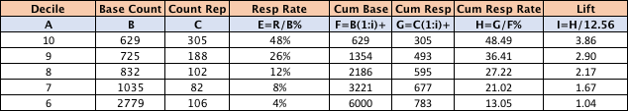
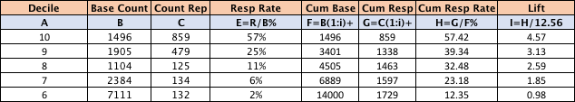
MODEL PERFORMANCE ON HOLDOUT – 2/3
Holdout Lift Chart
Development Lift Chart
The lift in Holdout sample is ~4 times in the top decile as compared to 4.6 times in the Development sample
Overall lift in the Holdout sample is consistent and is at least ~1.7 times on more than50 % of the sample size

Slide 48
Original vs Engineered Data MODEL comparison

Slide 49
Model Comparison - Original Vs Engineered – 1/2
In terms of Variable Importance, there seems to be difference in identification of variables across the original dataset and engineered dataset.
It is good to see that 3 of the newly created features is appearing as important feature in the engineered dataset model.
Accuracy wise SCR which was shown important in the original dataset is not shown to be very significant in the engineered dataset. Total number of debit transactions followed by the engineered variable of Average amount of credit transactions per month are important variables in the engineered dataset.
OCCUPATION seems to have gained importance in the engineered dataset as per decrease in GINI where as Total transaction counts was the equivalalent in the orgininal dataset.

Slide 50
Model Comparison - Original Vs Engineered – 2/2
When comparing the models developed from the original data and the engineered data, the same are not very drastically different. However, there is some added benefits to the model developed with the engineered variables.
As we can see, the KS statistic has improved by ~4% in the engineered dataset. Which clearly tells that there is an improvement in the prediction of expected target as compared to the original model.
The AUC remains relatively similar where as GINI has reduced which is good.
Comparing the test on holdout samples of both Original and Engineered datasets, the below are observed.
Although marginal, there is an improvement in the response rate in the test on holdout sample of engineered data. It has improved from 47% in original to 48% in the engineered data.
The improvement is seen in terms of LIFT as well. The holdout test on original data showed a top decile LIFT of 3.71 times whereas the same on engineered dataset is seen to have improved to 3.86 times.
Although the numbers seem marginal but given a larger volume they will have good numbers to prove.

Slide 51
Model Implementation Strategy
Until now, it is clearly visible that Data Analysis has helped building models that is predicting to better the initial target rate of 12.56 %.
Both of our models, the first on the original data and the next on the engineered data has shown good improvements in terms of numbers that showcases improvement in the response rate.
The response rate that we achieved from our Ramdom Forest models shows a minimum of ~1.7 increase in the positive responses.
The response rates of 55% and 47% in development and holdout samples respectively from the original dataset and similarly 57% and 48% in the engineered dataset in the respective top deciles are significantly better than the initial response rate of 12.56%. However, business / marketing team has to take a call on the number they want to proceed with.
With a non-medical reason and not much of cost difference, the team feels confident that MyBank’s marketing team can safely go ahead with either of the models with original data or engineered data and still come up with a better outcome.

Slide 52
ASSUMPTIONS

Slide 53
ASSUMPTIONS
The initial dataset taken for assessing the Hypothesis testing has been based on the correlation seen on the variables. Also, a subset of the original dataset has been taken as a sample for the Hypothesis Testing. This is only for the ease of validation and reducing computational expense.
The dataset is heavily unbalanced and running a random forest is definitely not a right approach. The data needed to be made near balanced by either oversampling, undersampling or by any other means. The sampling methods have not been used as part of this exercise.
As required by the exercise, team worked only on Random Forest. Although, Neural Network was tried but the performance was found to be better in Random Forest; hence the team continued with the later.
The significance of a variable ACC_OP_DATE was found to be redundant by the team as the dataset already had the variable LEN_OF_RLTN_IN_MNTH. Hence, the former was removed while working on the model.

